Slide 1
Complex Number
Nazmul Kader Chowdhury

Slide 2


Why Were Complex Numbers Invented?

Slide 3
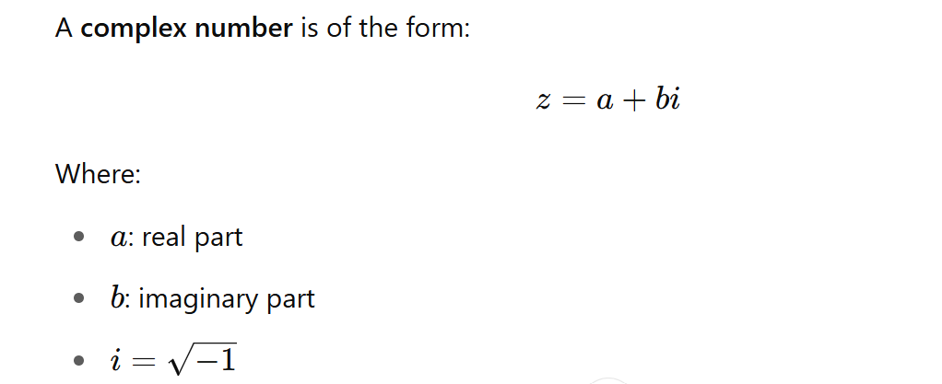
Definition of a Complex Number

Slide 4


What is the Conjugate of a Complex Number?

Slide 5
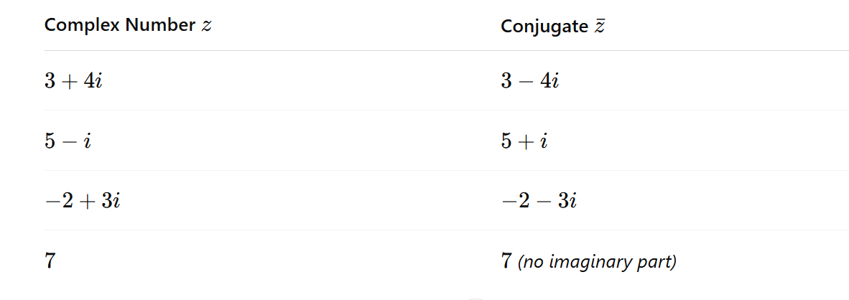

Slide 6



Slide 7


